Slide 1
Modal Testing and Analysis
Saeed Ziaei-Rad

Slide 2
Single Degree-of-Freedom (SDOF)
Undamped
Viscously Damped
Hysterically (Structurally) Damped

Slide 3
Undamped Systems (Theory)
F(t)
Spatial Model (Free vibration)
m
k

Slide 4
Undamped Systems (Forced vibration)
FRF=Frequency
Response Function

Slide 5
Viscous Damping (Free Vibration)
Oscillatory solution

Slide 6
Viscous Damping (Forced Vibration)

Slide 7
Structural Damping
# Viscous damping is not a good representative of real structures.
# Damping in real structures is frequency-dependent.
# A damper whose rate varies with frequency.
f
f
f
x
x
x
Viscous damper Dry friction Structural damping

Slide 8
Structural Damping
Equivalent Viscous damping
=Structural damping loss factor

Slide 9
Alternative Forms of FRF
Receptance
Mobility
Inertance or accelerance

Slide 10
Relation between receptance and mobility

Slide 11
Relation between receptance and Inertance

Slide 12
Definition of FRFs
Response Parameter: R | Standard FRF: R/F | Inverse FRF: F/R
Displacement | Receptance Admitance Dynamic Flexibility Dynamic Compliance | Dynamic Stiffness
Velocity | Mobility | Mechanical Impedance
Acceleration | Inertance Accelerance | Apparent Mass

Slide 13
Graphical Display of FRFs
Modulus of FRF vs. frequency and phase vs. frequency (Bode type of plot)
Real part of FRF vs. frequency and imaginary part vs. frequency
Real part of inverse FRF vs. frequency (or frequency^2) and imaginary part of inverse FRF vs. frequency (or frequency^2)
Real part of FRF vs. imaginary part of FRF (Nyquist type of plot)

Slide 14
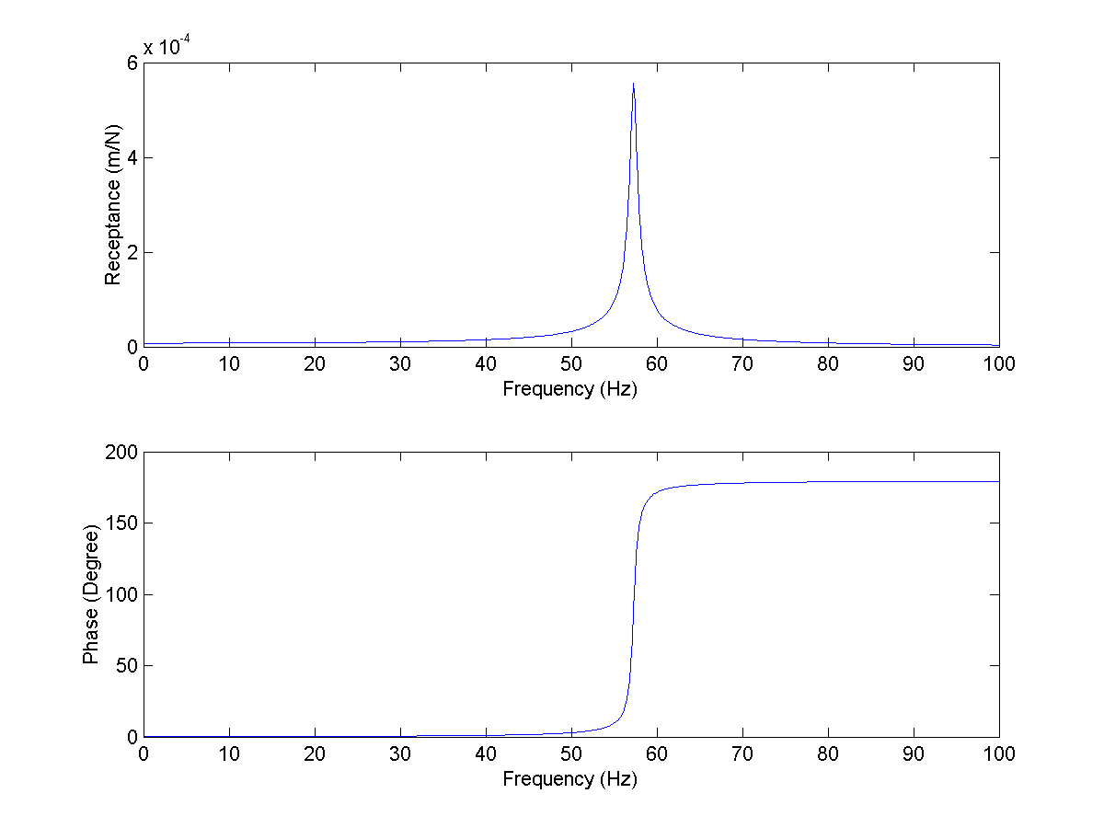
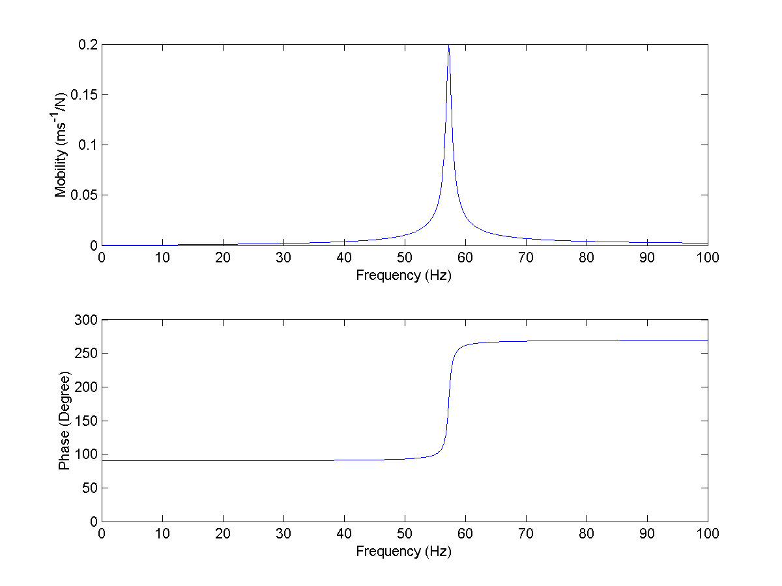
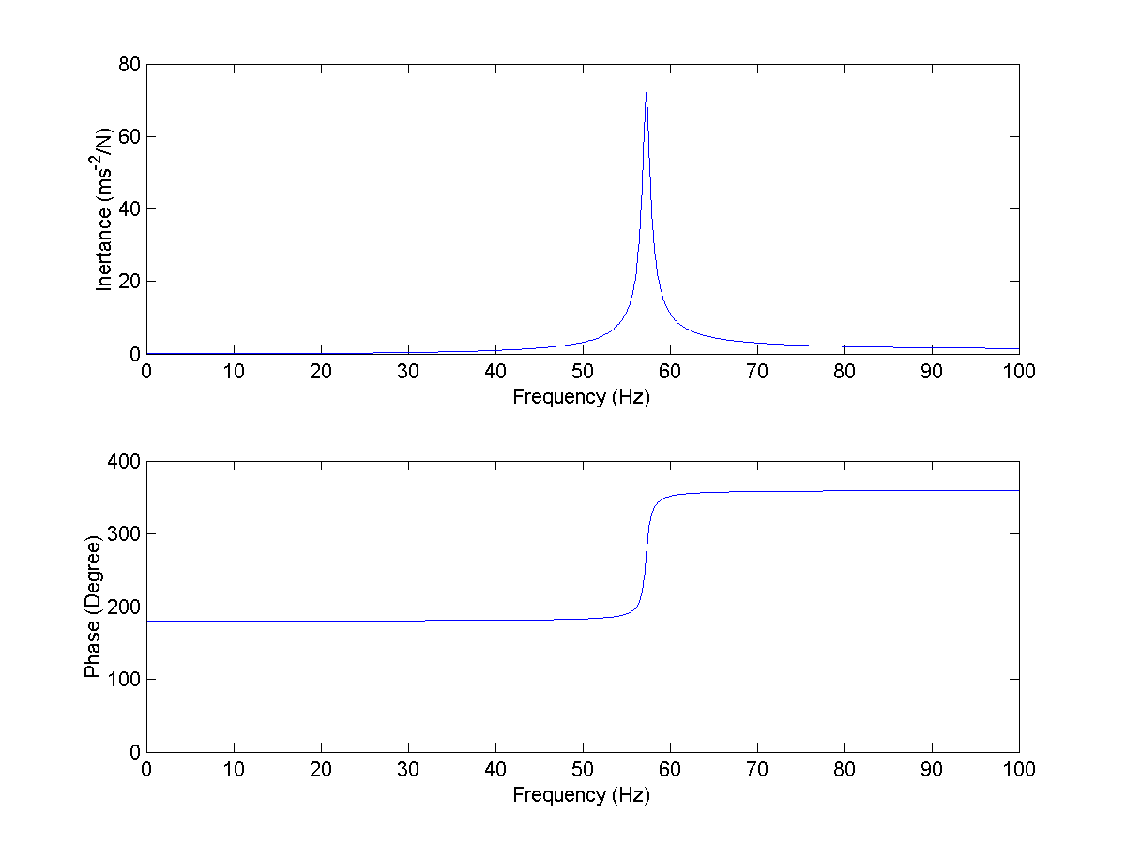
Modulus vs. Frequency
Receptance FRF
Mobility FRF
Inertance FRF

Slide 15
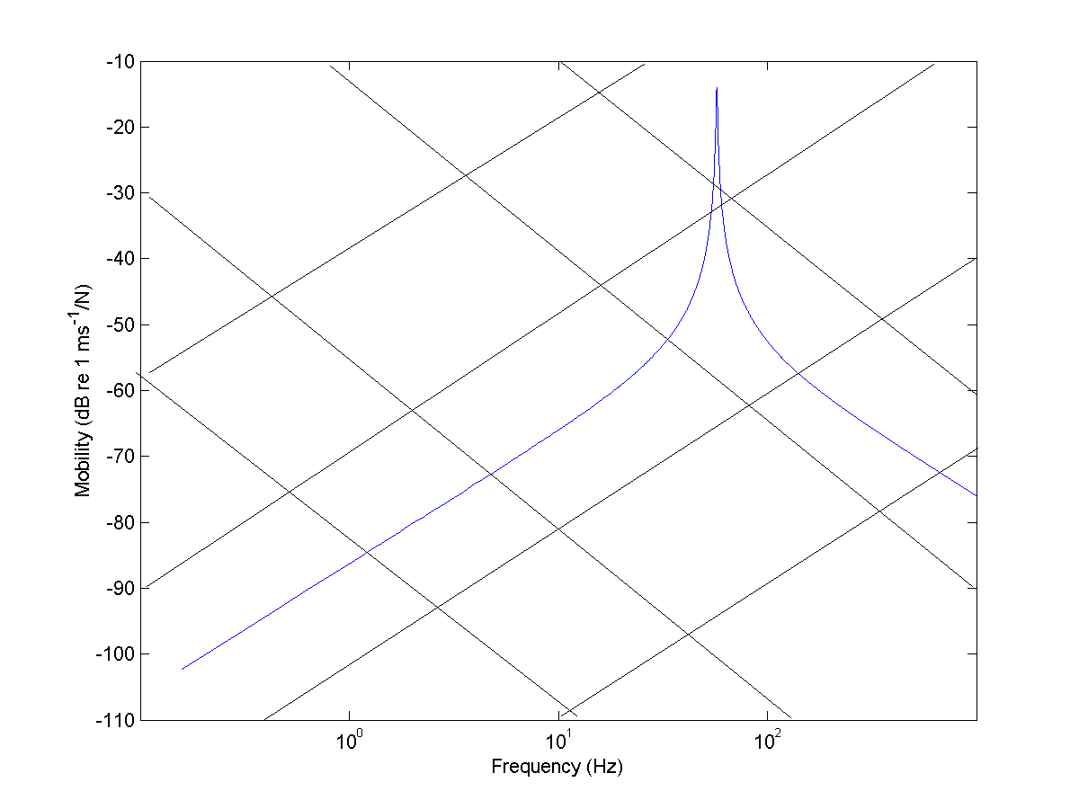
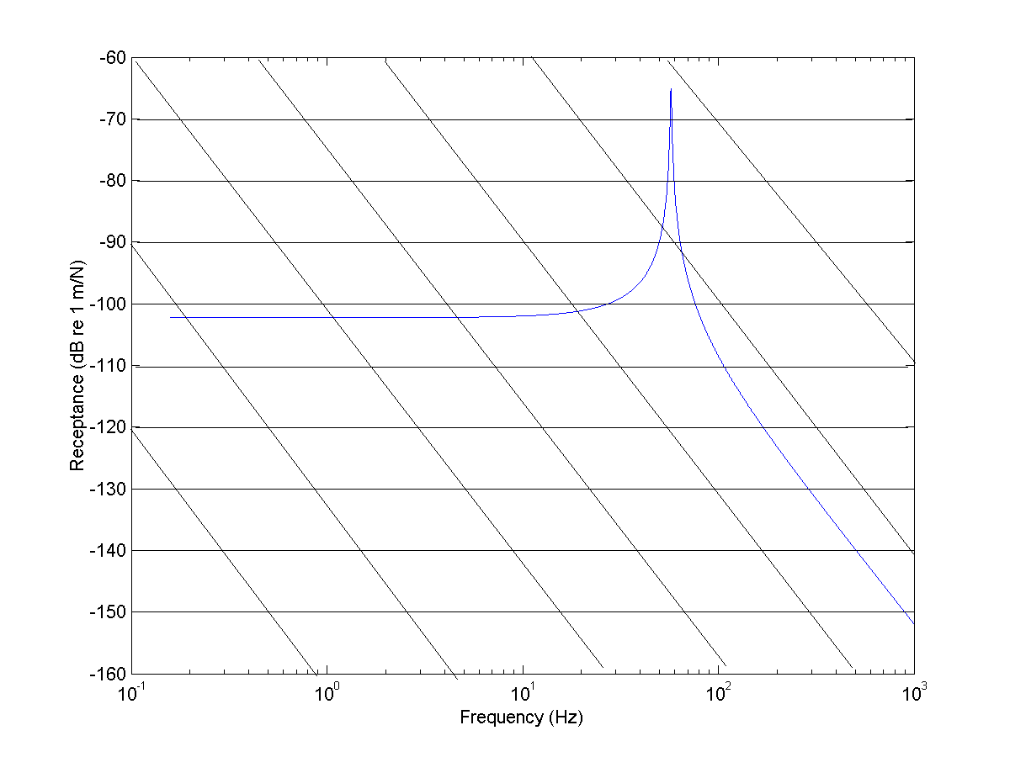
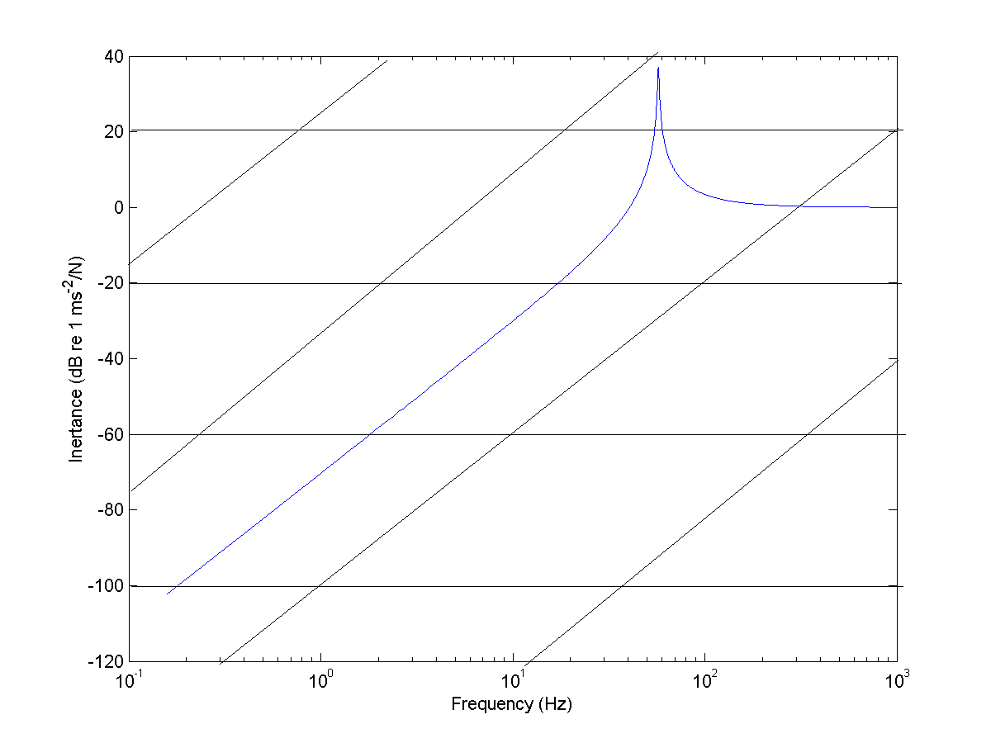
Modulus vs. Frequency
M=10
K=100000
K=100000
M=10
M=100
K=1000000
M=100
K=1000000
K=100000
Receptance FRF
Mobility FRF
M=10
K=1000000
M=100
Inertance FRF

Slide 16
Modulus vs. Frequency
A low Frequency straight-line (correspond to stiffness)
A high frequency straight-line (correspond to mass)
The resonant region with its abrupt magnitude and phase variation

Slide 17
Frequency Response of Mass and stiffness Elements
FRF | Mass | Stiffness

Slide 18
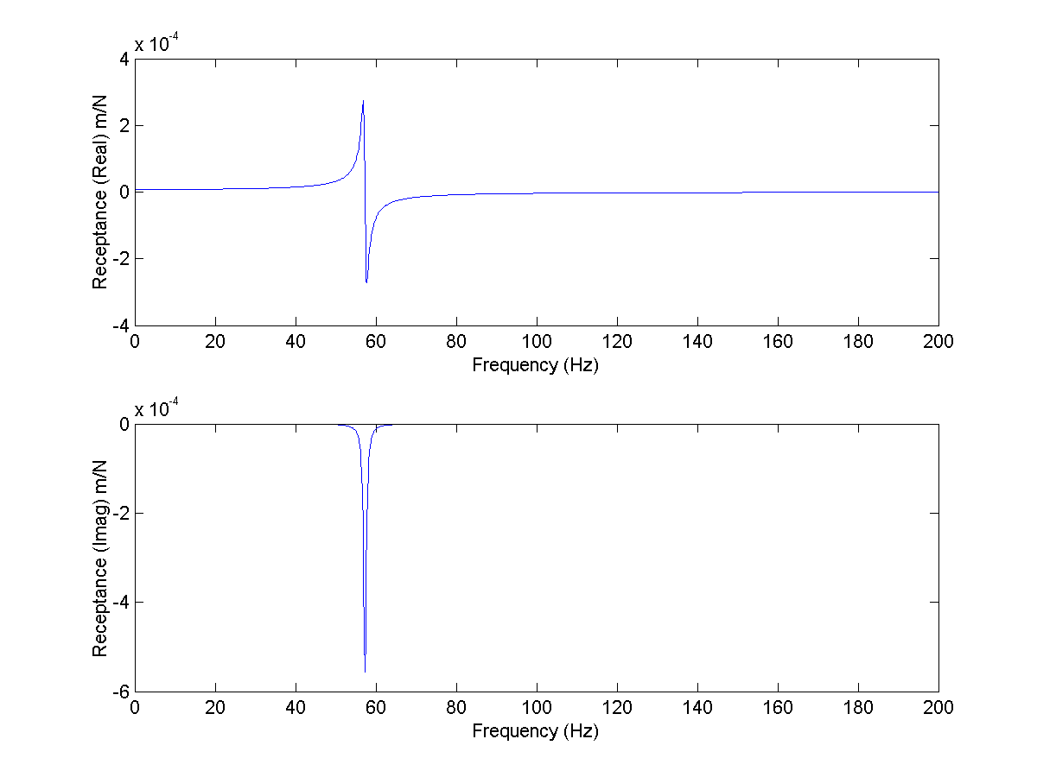
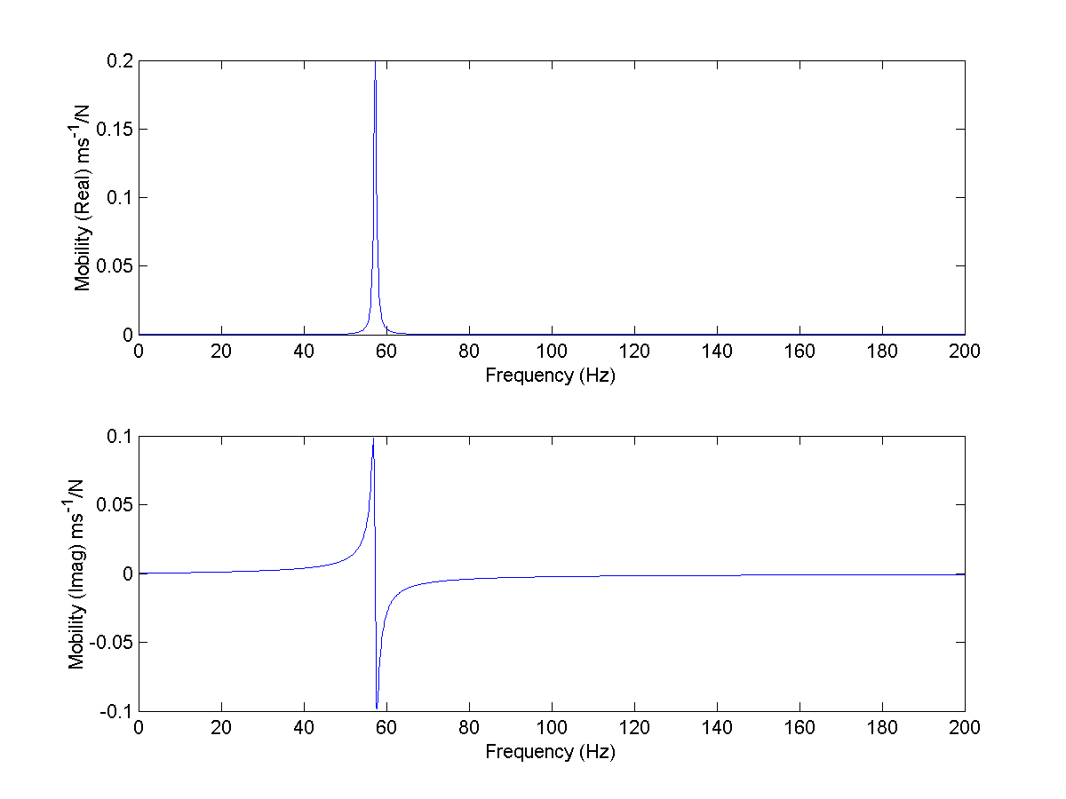
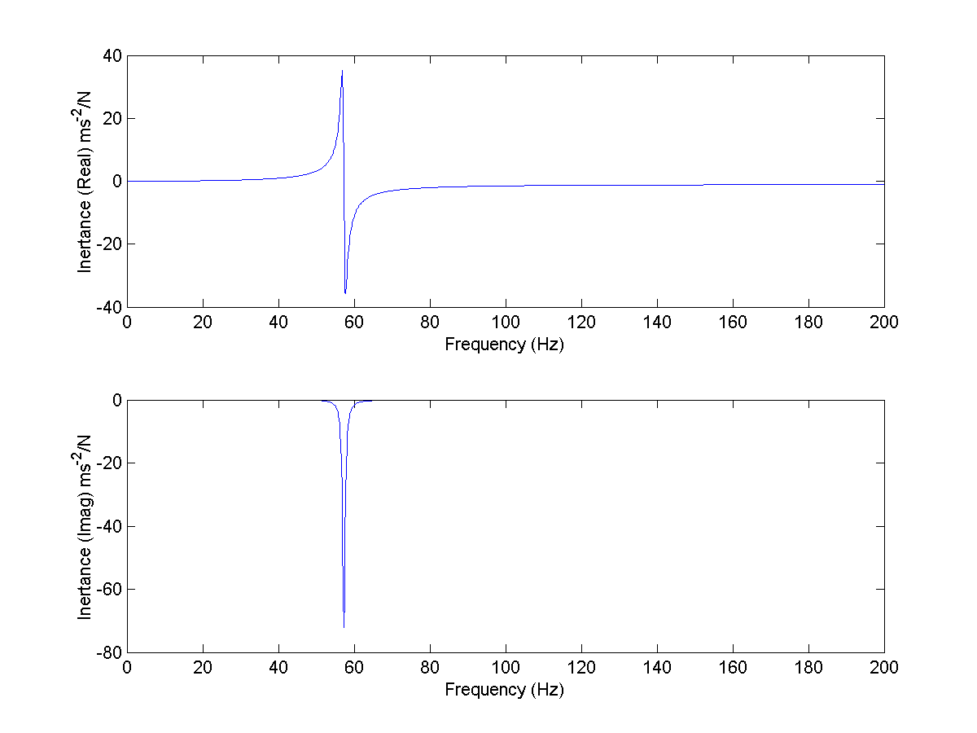
Real and Imaginary vs. Frequency
Receptancd FRF
Mobility FRF
Inertance FRF

Slide 19
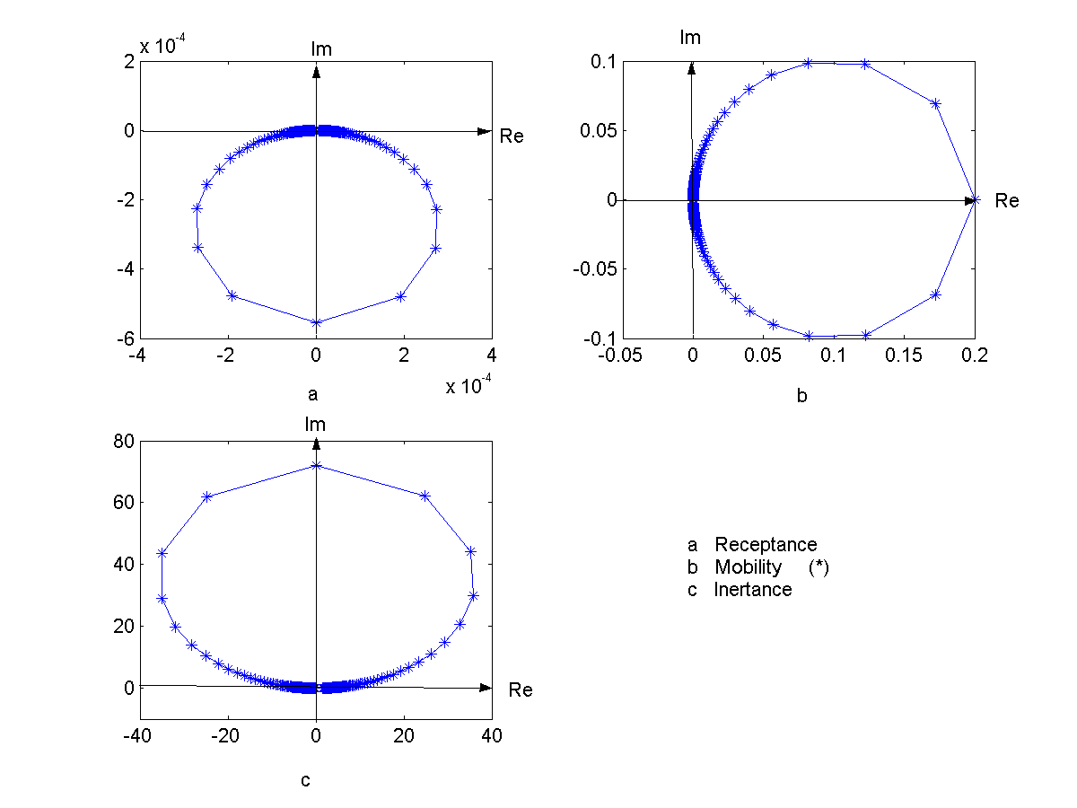
Real vs. Imaginary (Viscous Damping)

Slide 20
Real vs. Imaginary (Viscous Damping)

Slide 21
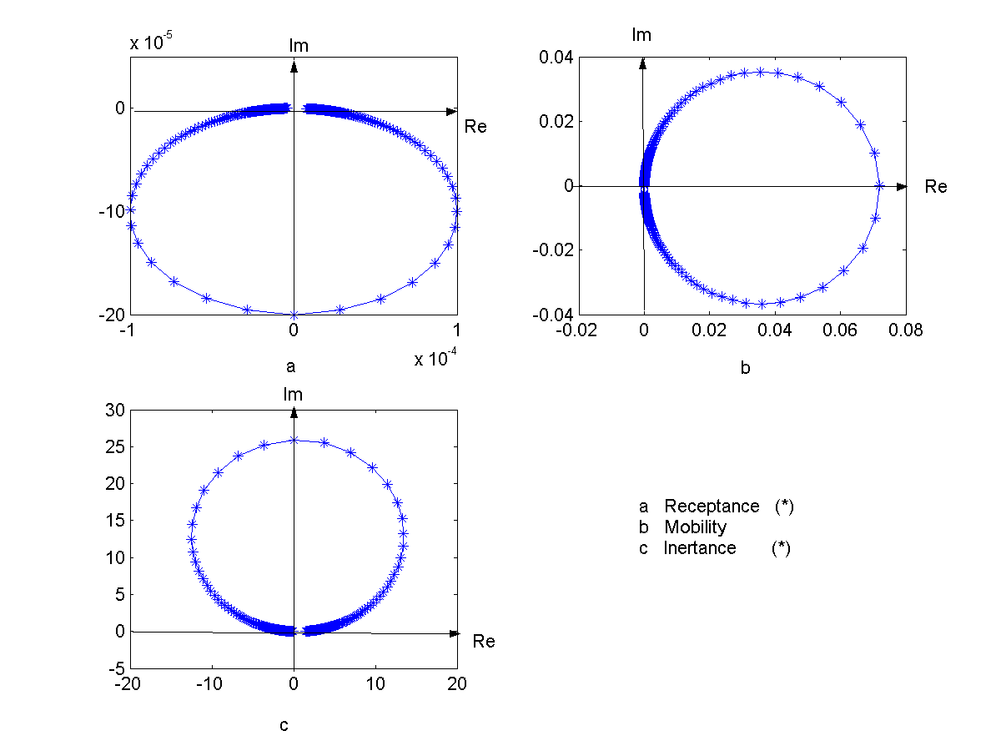
Real vs. Imaginary (Structural Damping)

Slide 22
Real vs. Imaginary (Structural Damping)

Slide 23
Conclusions
Close inspection of real structures suggests that viscous damping is not a good representative for MDOF systems.
All structures show a degree of structural damping.
Structural damping acts like an imaginary stiffness in frequency domain.
Modulus vs. Frequency and Nyquist type plots for FRFs are more common.

