Slide 1
Mode Indicator Functions
Course Instructor: Dr. S. Ziaei Rad
Isfahan University of Technology
Department of Mechanical Engineering
May 7th 2011

Slide 2
Introduction
Kinds of Mode Indicator Functions
RMIF
MMIF
MRMIF
CoMIF
ImMIF
CMIF

Slide 3
Introduction
Modal indicators are useful for estimating the effective number of modes in the frequency range of interest and for determining appropriated force vectors to isolate undamped normal modes of structures.
The mode indicator functions show the resonance frequencies, including repeated roots.
In practice MIFs have revealed differences in their ability to detect the position of resonances. Frequency, noise, leakage, non- linearities, high damping, use of more excitation points than effective number of modes, are factors influencing the accuracy of resonance location

Slide 4
The measured frequency response function (FRF) can be viewed also but with only one FRF it may very difficult to identify how many modes exist. From one measurement all the modes may not be easily observed; two very closely spaced modes may be very difficult to observe. So to assist in the process of pole selection, many different tools have been developed over the years. The main tools used are:
SUM- summation function
MIF- mode indicator function
Different kind of MIFs are:
RMIF ( real mode indicator function)
MMIF ( multivariate mode indicator function)
MRMIF ( modified real mode indicator function)
CoMIF ( coincident mode indicator function)
ImMIF ( imaginary mode indicator function)
CMIF ( complex mode indicator function)

Slide 5
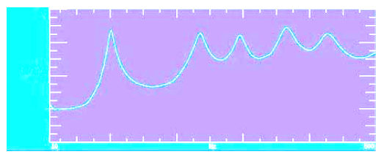
Basically, SUM is the sum of all the FRFs measured (or sometimes only a subset of all the FRFs is used).
The SUM will reach a peak in the region of a mode of the system. The idea is that if all the FRFs are considered, then all of the modes will be seen in the majority of the measurements.
As more and more FRFs are included, there is a greater chance that all of the modes will be seen in the collection of FRFs summed together.
The sum function will identify modes reasonably well specially if the mod are well separated.
While the SUM function is useful, it is not always very clear when modes are closely spaced.
The original MIF was formulated to provide a better tool for identifying closely spaced modes.

Slide 6
In one formulation, a cost function is first defined as the ratio of some norms of either the real, the imaginary or the total response. The mini (maxi) misation problem takes the form of a Rayleigh quotient. This is equivalent to a frequency dependent eigenvalues formulation, involving normal matrixes, formed from the FRF matrix or its real and imaginary components.
MIFs are defined by the eigenvalues of these matrix products, plotted against frequency. Usually, the existence of a mode of vibration is indicated by distinct troughs or peaks in the MIF plot.

Slide 7
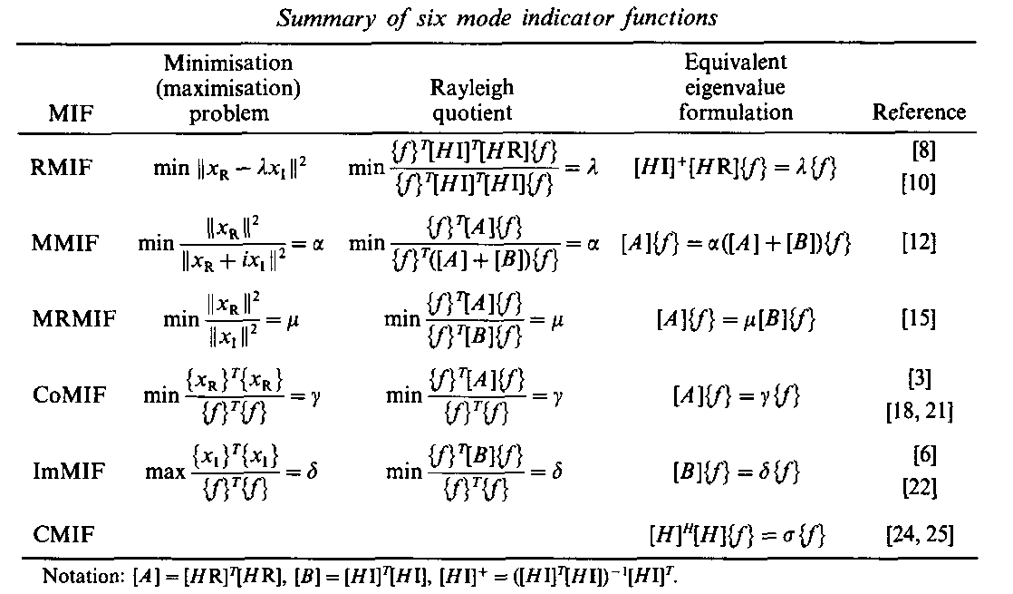
MIF CONCEPTS
The relationship between the complex vector of steady state response {x} and the real force vector {f} is given by
In a given frequency band, the number of dominant modes is less or equal to the smallest dimension of FRF matrix. A summary of the definitions of six MIFs is shown in below table.

Slide 8
RMIF
The MIF is defined by the frequency dependence of eigenvalues of the matrix product .They are the measure of the ratio of reactive energy to active energy transmitted to the structure during a cycle of forced vibration.
The theoretical background of the RMIF is different from that of other MIFs. Instead of looking directly for a real normal mode, by minimizing the ratio of out- of- phase energy to total energy, implying proportionality between the real part and the imaginary part of the response vector.
There are many RMIF curves as points of excitation. Each curve can cross the frequency axis several times. Only zero crossing with positive slope indicate undamped natural frequencies (NUFs) .

Slide 9
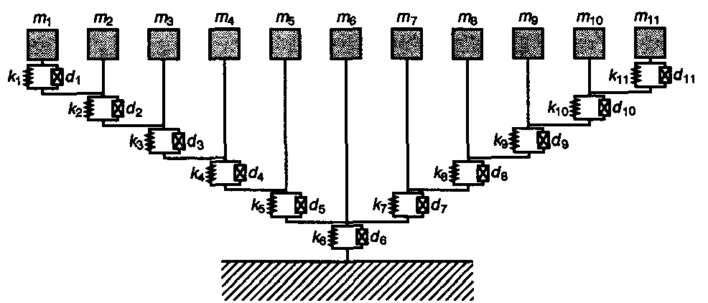
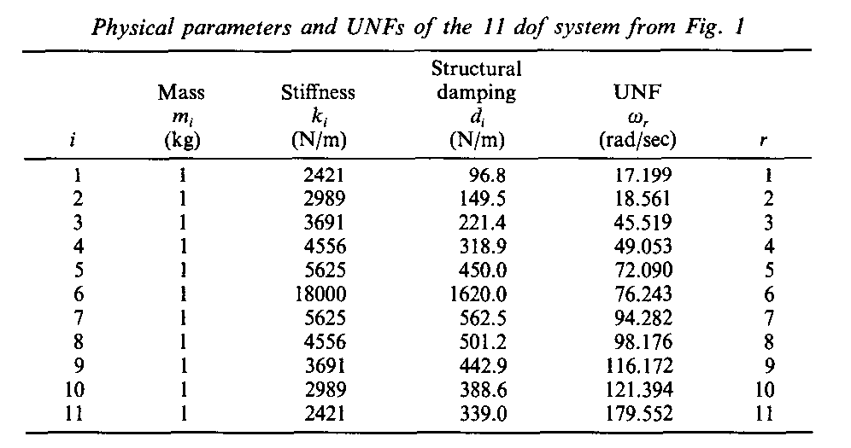
Numerical Simulation
The MIF concepts have been applied to an 11-dof system with structural damping.

Slide 10
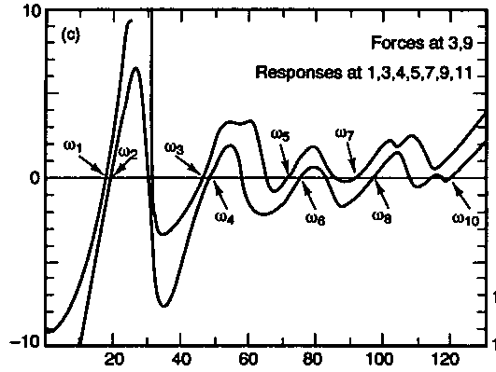
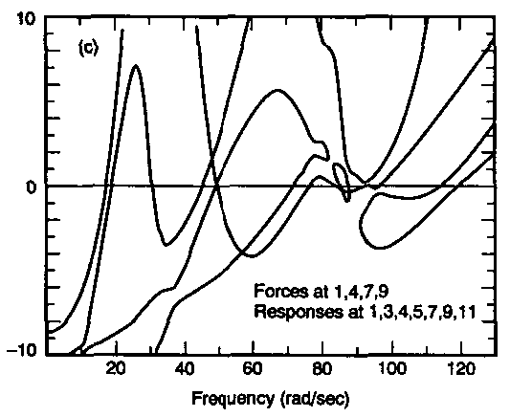

Slide 11
MMIF
Basically the mathematical formulation of the MIF is that the real part of FRF is divided by the magnitude of the FRF. Because the real part rapidly passes through zero at resonance, the MIF generally tends to have a much more abrupt change across a mode. The real part of the FRF will be zero at resonance and therefore the MIF will drop to a minimum in the region of a mode.
An extension of the MIF is the multivariate MIF(MMIF), which is an extended formulation of MIF for multiple referenced FRF data. The big advantage is that multiple referenced data will have multiple MIFs (one for each reference) and can detect repeated roots.
If the first MIF drops, then there is an indication that there is a pole of the system. Now if the second MIF also drop at the same frequency as the first MIF, then there is an indication that is a repeated root.

Slide 12
Mathematical background
The structural response X(w) is steady state for a purely real force vector F(w), and is given by
Where H(w) is the frequency response function matrix.

Slide 13
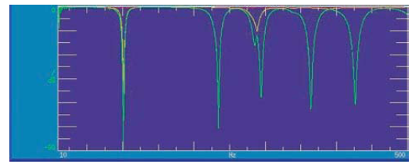
Plotting the smallest eigenvalue as a function of frequency gives a multivariate mode indicator function. Repeating the procedure for the second smallest eigenvalue reveals which frequencies, if any, are repeated mode.
A modest drop in the secondary MIF occurs at the closely spaced modes; whereas, at the repeated root the secondary MIF is almost as low as the primary MIF.

Slide 14
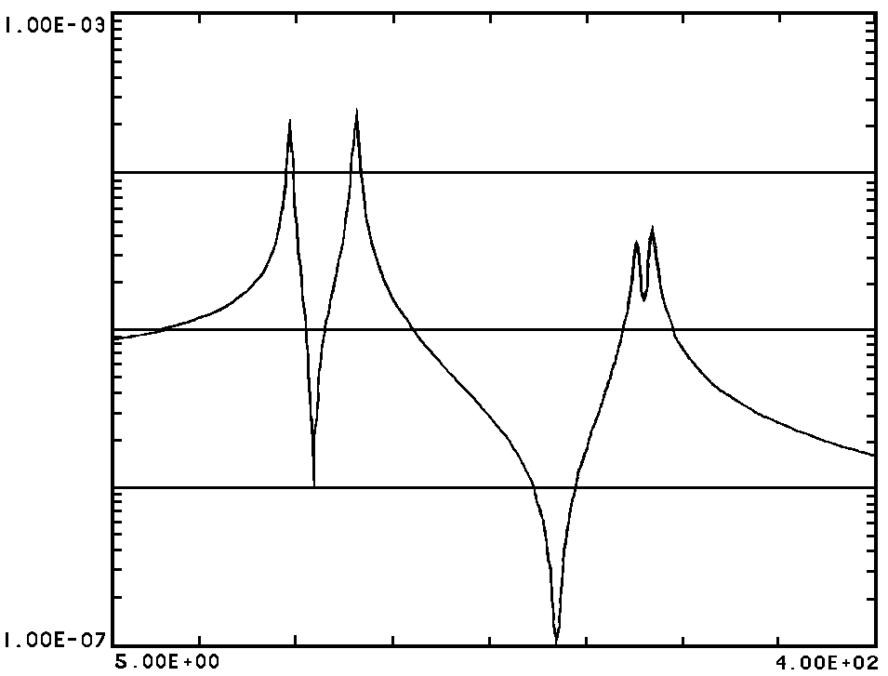
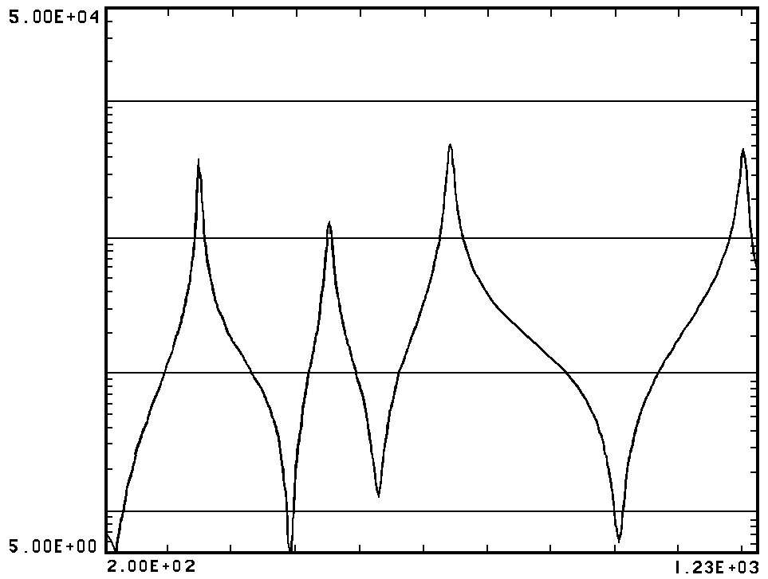
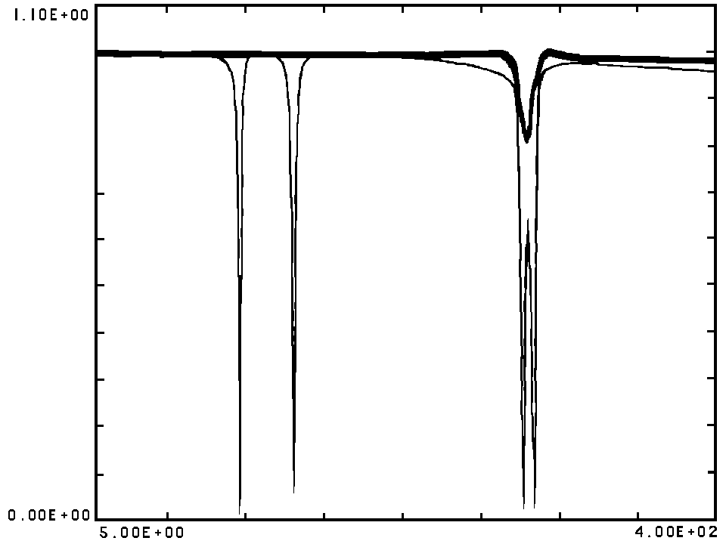
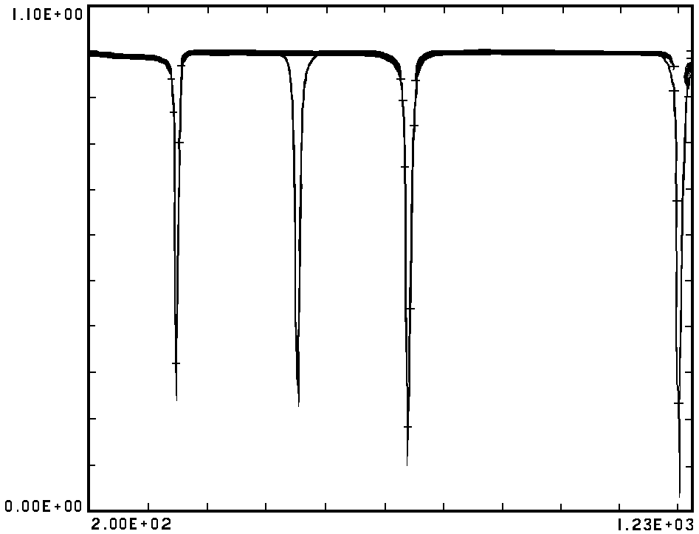

Slide 15
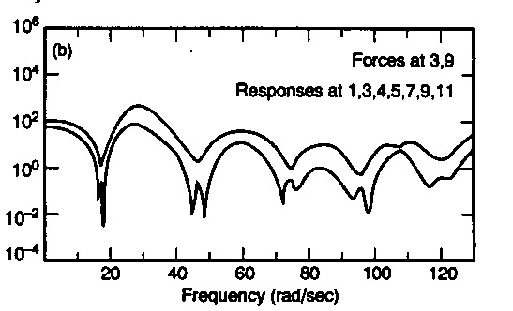
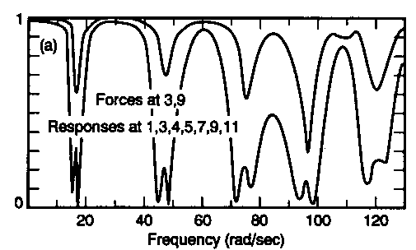
MRMIF
The modified real mode indicator function (MRMIF) is defined by the frequency dependence of eigenvalues of the generalized problem

Slide 16
CMIF & ImMIF & CoMIF
In modal parameter estimation area, one of the greatest difficulties is to determine the number of degrees of freedom of the system in the frequency range of interest in order for the modal parameter estimation.
The CMIF is defined as the eigenvalue solved from the normal matrix formed from FRF matrix, at each spectral line.
The CMIF is plot of these eigenvalues on a log magnitude scale as a function of frequency.

Slide 17
CMIF & ImMIF & CoMIF
Normal matrix is obtained by premultiplyingthe FRF matrix by its Hermitian matrix as:
The concept of CMIF is developed by performing Singular Value Decomposition (SVD) of the Frequency Response Function (FRF) matrix at each spectral line.
SVD is a more practical approach that did not require the matrix product of ${\left[H(jω)\right]}^{H}\left[H(jω)\right]$ and subsequent numerical issues.

Slide 18
CMIF & ImMIF & CoMIF

Slide 19
CMIF & ImMIF & CoMIF
Where:
: Left singular vector (approximate mode shapes)
: Right singular vector
(approximate modal participation factors)
Mode scaling factor

Slide 20
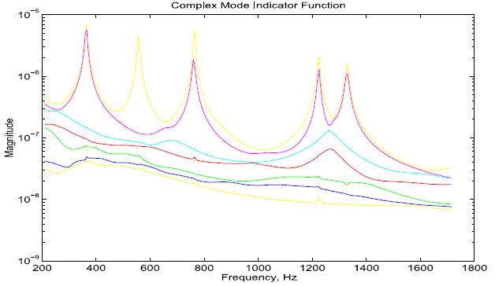
CMIF & ImMIF & CoMIF
Therefor the peaks detected in CMIF plot indicate the existence of modes, and the located frequencies give the corresponding damped natural frequencies.
Number of curves in MIF is equals the number of excitation points.

Slide 21
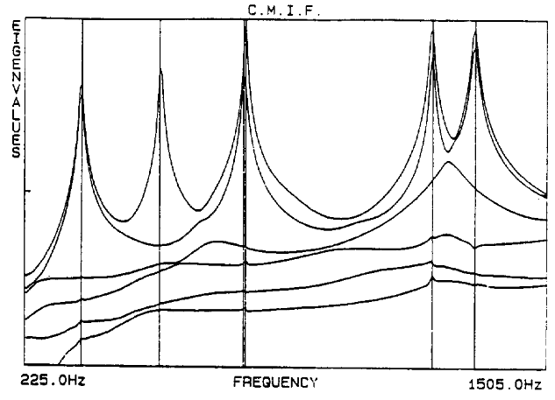
CMIF & ImMIF & CoMIF
If different modes are compared, the stronger the mode contribution, the larger the singular value will be (In other words the magnitude of the eigenvalue indicates the relative magnitude of the mode, residue over damping factor).
Frequency resolution plays an important rule…
Case of Repeated mode
Number of modes
(5 or 9)?

Slide 22
CMIF & ImMIF & CoMIF
It must be noted that NOT all peaks in CMIF indicate modes. Errors such as noise, leakage, nonlinearity and cross eigenvalue effect can also make a peak.
Cross eigenvalue effect: at a specific frequency it is possible that the contribution of two modes be equal, therefore at this frequency two singular value or eigenvalue cross each other.
Limited frequency
The way that the CMIF is plotted
Sorted vs. Tracked
Therefore the peak in this case is not a system pole.

Slide 23
CMIF & ImMIF & CoMIF
Sorted vs. Tracked (For all MIFs):
Usually, MIF curves are plotted as a function of magnitude, based on sorted Eigenvalues.
Points representing the smallest eigenvalue, the second eigenvalue, etc. are connected separately.
Cross-over peaks or through occur,
which have to be carefully analyzed.

Slide 24
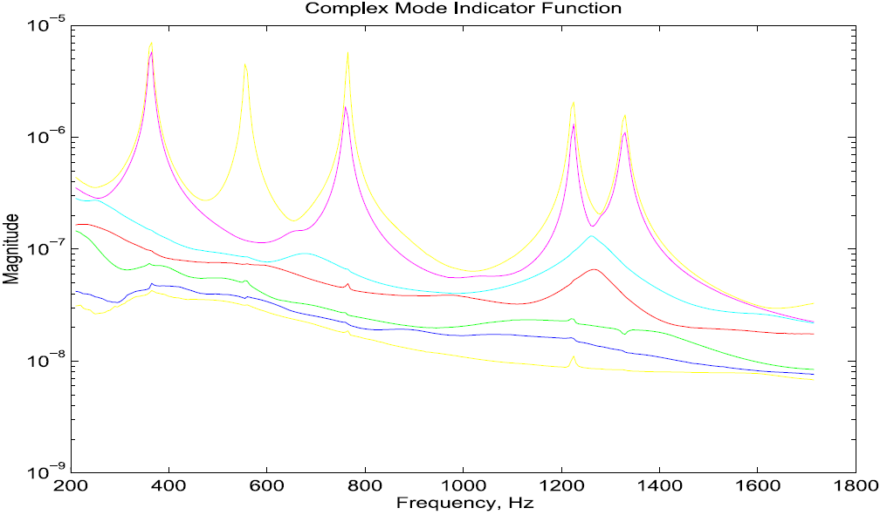
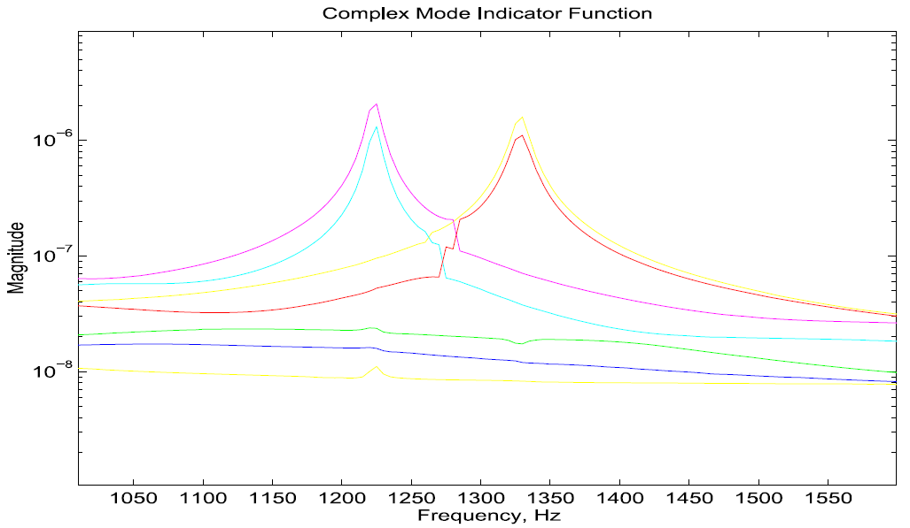
CMIF & ImMIF & CoMIF
Sorted vs. Tracked…

Slide 25
CMIF & ImMIF & CoMIF
By including several spectral lines of data in the SVD calculation, the effect of the leakage error and noise contamination can be minimized.
ImMIF
CoMIF

Slide 26
ImMIF & CoMIF
CoMIF
Eigenvalues will be calculated at each spectral lines and plotted against frequency; usually on a log magnitude scale.
Local minima define the UNFs.
False minima occur even for noise free measurement data.
CoMIF is usually referred to as the extended Asher method.

Slide 27
ImMIF & CoMIF
ImMIF
: imaginary mode indicator funtion.
Local peaks of the largest eigenvalues define the UNFs.
Its performance declines greatly for structures with high modal density.
log magnitude scale is used to sharpen the peaks.

Slide 28
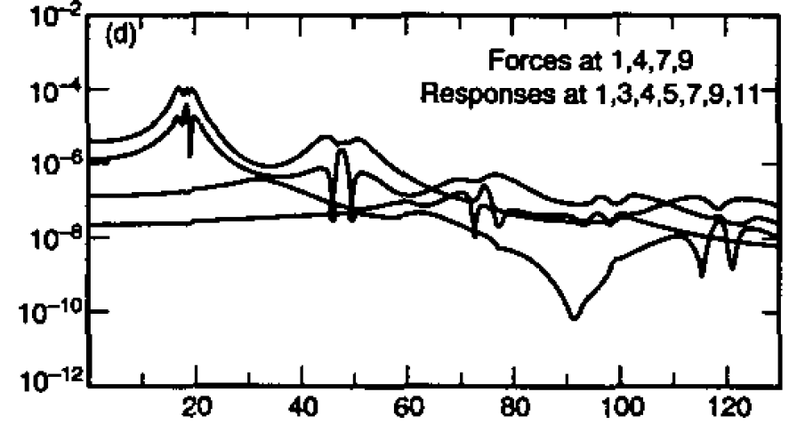
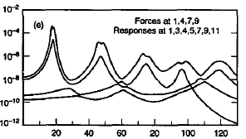
ImMIF & CoMIF
CoMIF
ImMIF
CoMIF and ImMIF have inherent limitations, especially for high damped system.
The main drawback is the use of only a part of the available frequency response.

Slide 29
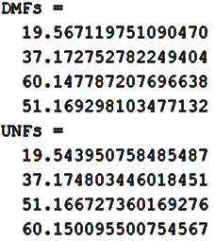
Application
Application of MIFs for a mechanical system - using MATLAB…

Slide 30
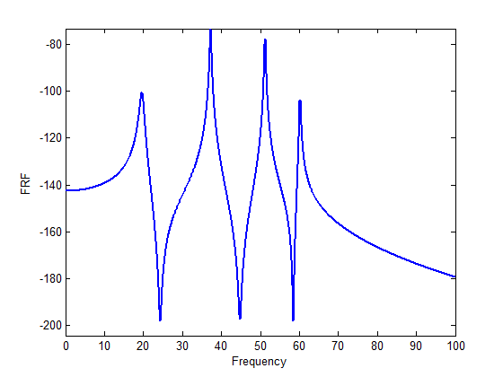
Application
Application of MIFs for a mechanical system - using MATLAB…

Slide 31
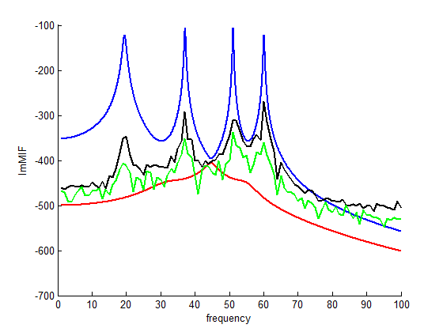
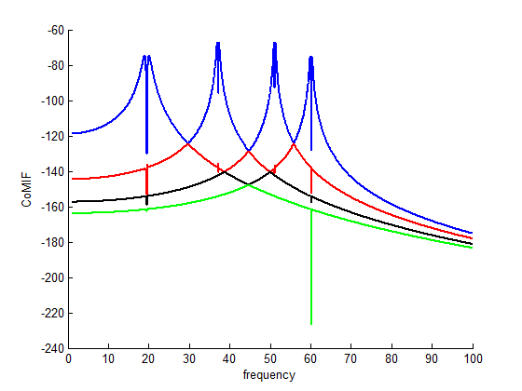
Application
Application of MIFs for a mechanical system - using MATLAB…

Slide 32
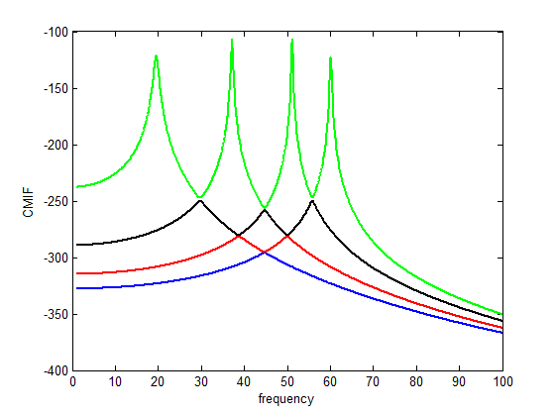
Application
Application of MIFs for a mechanical system - using MATLAB…

Slide 33
Thanks for your attention

